Slide 1
Introduction To Servlets

Slide 2
Objectives
Below are the objectives of this course
Understanding Hierarchy Of Servlets
Knowing about GenericServlet, Httpservlet And their differences
The Life Cycle of a Servlet.
Differences Between doGet() And doPost()
Calling Servlets from Form Pages
Servletconfig Object And Its Methods
Servletcontext Object And Its Methods.
Servletrequest Object And Its Methods.
Servletresponse Object And Its Methods

Slide 3
Hierarchy of Servlet
The Servlet Class Hierarchy consists of two top level interfaces
which are implemented by the GenericServlet Class. They are
javax.servlet.Servlet
javax.servlet.ServletConfig
The GenericServlet class is extended by the HttpServlet class.
The HttpServlet class is extended by the user defined servlet class.

Slide 4
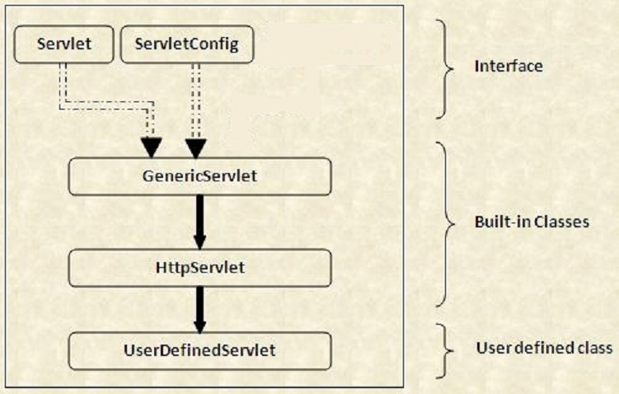
Hierarchy of Servlets

Slide 5
GenericServlet and HttpServlet
One similarity between GenericServlet and HttpServlet is that they both are
Abstract Classes. Also the GenericServlet is the super class of HttpServlet.
GenericServlet is an abstract class that defines a generic, protocol-independent
Servlet. Any protocol dependent Servlet has to extend this class in order to
provide a specific implementation and override service() method. One such an
example class is HTTPServlet class, which extends GenericServlet class.

Slide 6
Difference between GenericServlet and HttpServlet
Sno | GenericServlet | HttpServlet
1 | GenericServlet is protocol independent. Which means GenericServlet can handle all types of protocols. | HttpServlet is a protocol dependent. Which means HttpServlet can handle only HTTP specific protocols.
2 | GenericServlet belongs to javax.servlet package | HttpServlet belongs to javax.servlet.http package.
3 | GenericServlet is an abstract class which extends Object and implements Servlet, ServletConfig and java.io.Serializable interfaces. | HttpServlet is an abstract class which extends GenericServlet and implements java.io.Serializable interface.
4 | GenericServlet does not contain doGet() and doPost() methods. | HttpServlet extends GenericServlet and adds support for doGet(), doPost(), doHead() methods (according to HTTP 1.0) and doPut(), doOptions(), doDelete(), doTrace() methods (accoridng to HTTP 1.1).

Slide 7
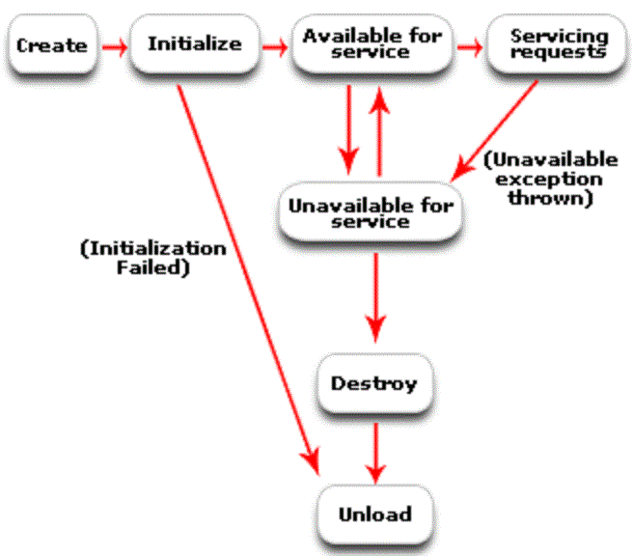
Servlet – Life Cycle

Slide 8
Servlet – Life Cycle
The Servlet's life cycle can be categorized into four stages.
1. Loading and Instantiation: The servlet container loads the servlet during startup or when the first request is made. After loading of the servlet, the container creates the instances of the servlet.
2. Initialization: After creating the instances, the servlet container calls the init() method and passes the servlet initialization parameters to the init() method. The init() must be called by the servlet container before the servlet can service any request. The initialization parameters persist until the servlet is destroyed. The init() method is called only once throughout the life cycle of the servlet.
The servlet will be available for service if it is loaded successfully otherwise the servlet container unloads the servlet.

Slide 9
Servlet – Life Cycle Methods
3. Servicing the Request: After successfully completing the initialization process, the servlet is available for service. Servlet creates separate threads for each request. The servlet container calls the service() method for servicing any request. The service() method determines the kind of request and calls the appropriate method (either doGet() or doPost() of the user defined servlet) for handling the request and sends response to the client using the methods of the response object.
4. Destroying the Servlet: If the servlet is no longer needed for servicing any request, the servlet container calls the destroy() method . Like the init() method this method is also called only once throughout the life cycle of the servlet. Calling the destroy() method indicates to the servlet container not to send any request for service and the servlet releases all the resources associated with it.

Slide 10
Difference between doGet and doPost
S No | doGet() | doPost()
1 | The parameters are appended to the URL and sent along with header information | Sends the information through a socket back to the webserver and it won't show up in the URL bar
2 | The amount of information sent using GET is restricted as URL can only be 1024 characters. | Can send much more information to the server this way
3 | Requests for information; it does not (or should not) change anything on the server. (doGet() should be idempotent) | doPost() provides information (such as placing an order for merchandise) that the server is expected to remember
4 | Parameters are not encrypted | Parameters are encrypted
5 | doGet() is faster if we set the response content length since the same connection is used. Thus increasing the performance | doPost() is generally used to update or post some information to the server.doPost is slower compared to doGet since doPost does not write the content length
6 | It allows bookmarks. | It does not allows bookmarks.

Slide 11
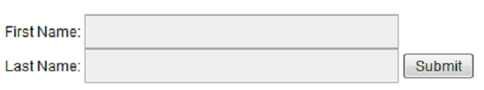
Calling Servlet from Form - Example
HTML Page Layout
TCS
HTML Code
ILP
<html>
<body>
<form action="WelcomeForm" method="GET">
First Name: <input type="text" name="firstName">
<br />
Last Name: <input type="text" name="lastName" />
<input type="submit" value="Submit" />
</form>
</body>
</html>

Slide 12
Calling Servlets from Forms
Servlet Code
package com.tcs.ilp;
import java.io.*;
import javax.servlet.*;
import javax.servlet.http.*;
public class WelcomeForm extends HttpServlet {
public void doGet(HttpServletRequest request, HttpServletResponse response)
throws ServletException, IOException
{
// Set response content type
response.setContentType("text/html");
PrintWriter out = response.getWriter();
String title = "Reading the data from Form";
out.println("<html>" + "<head><title>" + title + "</title></head>" +
"<body>" +
"<h1>" + title + "</h1>" +
"<ul>" +
" <li><b>First Name</b>: " + request.getParameter("firstName") +
" <li><b>Last Name</b>: " + request.getParameter("lastName") +
"</ul>" +
"</body></html>");
}
}

Slide 13
Calling Servlets from Forms
Servlet and its mapping entries in web.xml
<servlet>
<servlet-name>WelcomeForm</servlet-name>
<servlet-class>com.tcs.ilp.WelcomeForm</servlet-class>
</servlet>
<servlet-mapping>
<servlet-name>WelcomeForm</servlet-name>
<url-pattern>/WelcomeForm</url-pattern>
</servlet-mapping>
Output
Reading the data from Form
First Name: TCS
Last Name: ILP

Slide 14
ServletConfig Interface and its Methods
An object of ServletConfig is created by the web container for each servlet.
This object can be used to get configuration information from web.xml file.
Advantage
We need not modify the servlet, if the configuration information is modified in the web.xml file.
Methods
1.public String getInitParameter(String name):Returns the parameter value for
the specified parameter name.
2.public Enumeration getInitParameterNames():Returns an enumeration of
all the initialization parameter names.
3.public String getServletName():Returns the name of the servlet.
4.public ServletContext getServletContext():Returns an object of ServletContext.

Slide 15
ServletConfig Interface and its Methods
Getting Object of ServletConfig
public ServletConfig getServletConfig(): Returns the object of ServletConfig
Web.xml configuration
<servlet>
<servlet-name>ServletName</servlet-name>
<servlet-class>com.tcs.ilp.ServletDemo</servlet-class>
<init-param>
<param-name>email</param-name>
<param-value>ilp@tcs.com</param-value>
</init-param>
</servlet>
<servlet-mapping>
<servlet-name>ServletName</servlet-name>
<url-pattern>/Demo</url-pattern>
</servlet-mapping>
</servlet>

Slide 16
ServletConfig Interface and its Methods
Servlet Code Snippet
package com.tcs.ilp;
import java.io.*;
import javax.servlet.*;
import javax.servlet.http.*;
public class DemoServlet extends HttpServlet {
public void doGet(HttpServletRequest request, HttpServletResponse response)
throws ServletException, IOException {
response.setContentType("text/html");
PrintWriter out = response.getWriter();
ServletConfig config=getServletConfig();
String driver=config.getInitParameter("email");
out.print("Driver is: "+email);
out.close();
}
}

Slide 17
ServletContext Interface and its Methods
An object of ServletContext is created by the web container at time of deploying the project. This object can be used to get configuration information from web.xml file.
There is only one ServletContext object per web application. If any information is shared to many servlet, it is better to provide it from the web.xml file using the <context-param> element.
Advantages
Easy to maintain if any information is shared to all the servlets. It is better to make the information available for all the servlets by providing this information in the web.xml file. So if the information is changed, we needn’t modify the servlet. Thus it removes maintenance issues.

Slide 18
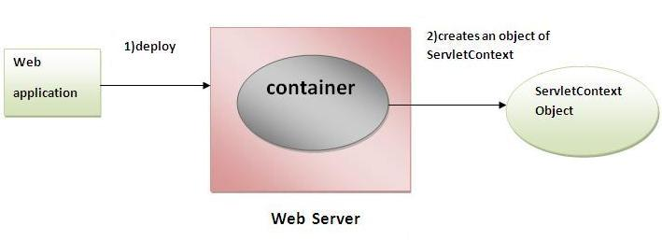
ServletContext Interface and its Methods
Usage of ServletContext Interface
Following are the usages of a ServletContext object:
1.The object of ServletContext provides an interface between the container and servlet.
2.The ServletContext object can be used to get configuration information from the web.xml file.
3.The ServletContext object can be used to set, get or remove attribute from the web.xml file.
4.The ServletContext object can be used to provide inter-application communication.

Slide 19
ServletContext Interface and its Methods
Commonly used methods of ServletContext
1.public String getInitParameter(String name):Returns the parameter value for the specified parameter name.
2.public Enumeration getInitParameterNames():Returns the names of the context's initialization parameters.
3.public void setAttribute(String name,Object object):sets the given object in the application scope.
4.public Object getAttribute(String name):Returns the attribute for the specified name.
5.public void removeAttribute(String name):Removes the attribute with the given name from the servlet context.

Slide 20
ServletContext Interface and its Methods
Getting Object of ServletConfig
getServletContext() method of ServletConfig interface returns the object of ServletContext.
getServletContext() method of GenericServlet class also returns the object of ServletContext.
Web.xml configuration
<servlet>
<servlet-name>ServletName</servlet-name>
<servlet-class>com.tcs.ilp.ServletDemo</servlet-class>
</servlet>
<context-param>
<param-name>email</param-name>
<param-value>admin@email.com</param-value>
</context-param>
</servlet>

Slide 21
ServletContext Interface and its Methods
Web.xml configuration
<servlet>
<servlet-name>ServletNameOne</servlet-name>
<servlet-class>com.tcs.ilp.ServletOne</servlet-class>
</servlet>
<context-param>
<param-name>email</param-name>
<param-value>admin@email.com</param-value>
</context-param>
</servlet>
<servlet-mapping>
<servlet-name>ServletNameOne</servlet-name>
<url-pattern>/DemoOne</url-pattern>
</servlet-mapping>
<servlet>
<servlet-name>ServletNameTwo</servlet-name>
<servlet-class>com.tcs.ilp.ServletTwo</servlet-class>
</servlet>
</servlet>
<servlet-mapping>
<servlet-name>ServletNameTwo</servlet-name>
<url-pattern>/DemoTwo</url-pattern>
</servlet-mapping>

Slide 22
ServletContext Interface and its Methods
Servlet Code Snippet
package com.tcs.ilp;
import java.io.*;
import javax.servlet.*;
import javax.servlet.http.*;
public class ServletTwo extends HttpServlet {
public void doGet(HttpServletRequest request, HttpServletResponse response)
throws ServletException, IOException {
response.setContentType("text/html");
PrintWriter out = response.getWriter();
ServletConfig config=getServletConfig(); s
String driver=config.getInitParameter("email");
out.print("Driver is: "+email);
out.close();
}
}
Note: parameter is accessible from other servlet
including the one its configured for.

Slide 23
ServletRequest Interface and its Methods
An object of ServletRequest is used to provide the client request information
to a servlet such as content type, content length, parameter names,its values,
header informations, attributes etc.
There are many methods defined in the ServletRequest interface.
Some of them are as follows:
1.public String getParameter(String name): is used to obtain the value
of a parameter by name.
2.public String[] getParameterValues(String name): returns an array of String
containing all values of given parameter name. It is mainly used to
obtain values of a Multi select list box.
3.public Enumeration getParameterNames(): returns an enumeration of all of
the request parameter names.

Slide 24
ServletRequest Interface and its Methods
4.public int getContentLength(): Returns the size of the request entity data,
or -1 if not known.
5.public String getCharacterEncoding(): Returns the character set encoding
for the input of this request.
6.public String getContentType(): Returns the Internet Media Type of the
request entity data, or null if not known.
7.public ServletInputStream getInputStream() throws IOException: Returns an
input stream for reading binary data in the request body.
8.public abstract String getServerName(): Returns the host name of the server
that received the request.
9. public int getServerPort(): Returns the port number on which this request
was received.

Slide 25
ServletRequest Interface and its Methods - Example
HTML Content
<form action="demo" method="get">
Enter your name<input type="text" name="firstName"><br>
<input type="submit" value="login">
</form>
Servlet Code Snippet
import javax.servlet.http.*;
import javax.servlet.*;
import java.io.*;
public class DemoServlet extends HttpServlet{
public void doGet(HttpServletRequest req,HttpServletResponse res)
throws ServletException,IOException
{
res.setContentType("text/html");
PrintWriter pw=res.getWriter();
String name=req.getParameter("firstName");//return the content in the textbox above
pw.println("Welcome "+name);
pw.close();
}}

Slide 26
ServletResponse Interface and its Methods
The response object is an instance of a javax.servlet.http.HttpServletResponse
object. Just as the server creates the request object, it also creates
an object to represent the response to the client.
Through this object the programmer can add new cookies or date stamps,
HTTP status codes etc.
Commonly used methods:
1. public String encodeRedirectURL(String url): Encodes the specified URL for
use in the sendRedirect method or, if encoding is not needed, returns the URL
unchanged.
2. public String encodeURL(String url): Encodes the specified URL by including the
session ID in it, or, if encoding is not needed, returns the URL unchanged.
3. public boolean containsHeader(String name): Returns a boolean indicating
whether the named response header has already been set.

Slide 27
ServletResponse Interface and its Methods
4. public boolean isCommitted(): Encodes the specified URL for
use in the sendRedirect method or, if encoding is not needed, returns the URL
unchanged.
5. public void addCookie(Cookie cookie): Adds the specified cookie to the response.
6. public void addHeader(String name, String value): Adds a response header
with the given name and value.
7. public void flushBuffer(): Forces any content in the buffer to be written to the client.
8. public void reset(): Clears any data that exists in the buffer as well as the
status code and headers.
9. public void sendError(int sc): Sends an error response to the client using the
specified status code and clearing the buffer.
10. public void sendError(int sc, String msg): Sends an error response to the
client using the specified status.

Slide 28
ServletResponse Interface and its Methods
11. public void sendRedirect(String location): Sends a temporary redirect response
to the client using the specified redirect location URL.
12. public void setCharacterEncoding(String charset): Sets the character encoding
(MIME charset) of the response being sent to the client.
13. public void setContentType(String type): Sets the content type of the response
being sent to the client, if the response has not been committed yet. .
14. public void setHeader(String name, String value): Sets a response header with
the given name and value.
15. public void setLocale(Locale loc): Sets the locale of the response, if the response
has not been committed yet.
16. public void setStatus(int sc): Sets the status code for this response.

Slide 29
      Reference Sites
http://www.j2eetutorials.50webs.com/servlet-hierarchy.html
http://www.javaken.com/forum/showthread.php?t=1493
http://www.roseindia.net/servlets/LifeCycleOfServlet.shtml
http://www.tutorialspoint.com/servlets/servlets-form-data.htm
http://www.javatpoint.com/servletconfig
http://www.tutorialspoint.com/jsp/jsp_server_response.htm

Slide 30


